Slide 1



Red Feather
Final Presentation
Team Red Feather: Nathan Fisher, Leann Hernandez, & Trevor Scott

Slide 2
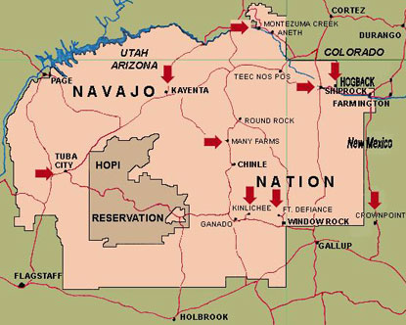
Project Description
Red Feather is a non-profit organization designed to help Native American residents on the Reservation with their housing needs
Residents of the reservation in Northern Arizona originally received coal to heat their homes from the mine supplying Navajo Generating Station, but the plant shut down in 2019.[1]
Burning coal creates respiratory health risks and as a result conditions like asthma are extremely common
The Red Feather Capstone team has been tasked with researching and designing a sustainable solution to heat homes of the Native American people [1]
Solar heaters are that renewable and inexpensive long-term solution.
Figure 1: Native American Reservation [1]

Slide 3
Design Requirements
Primary Engineering Requirements:
  Produce around 1500 watts/day
    Currently used commercial option heat output
  Low Cost: Cost around $400
    Commercial option costs $700-900
Secondary Requirements:
  Installable by two people(W<100lbs)
  Durable: plexiglass, wood, and aluminum construction with marine fan and robust solar panel.
  Quiet(dB <40)
Notes:
Note cost: initially $350 but could not get it down that low
How we met design requirements-later slides

Slide 4
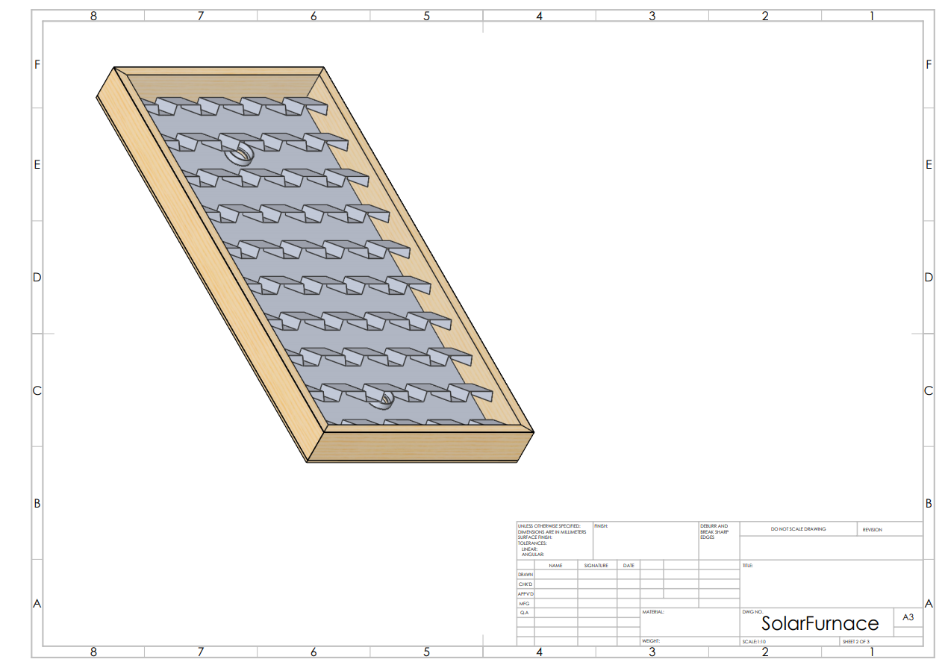
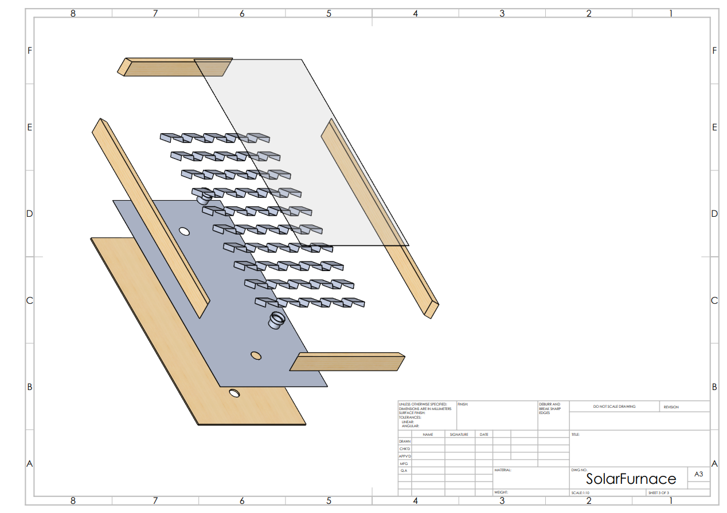
Design Description
Figure 2: Solar Furnace Assembly
Figure 3: Solar Furnace Assembly Exploded View
Notes:
Cad model does not reflect painted parts
Much simpler design than original model
Handmade corrugations rather than commercial corrugated sheet
Justification for this is in the following slides, a lot of it had to do with cost

Slide 5
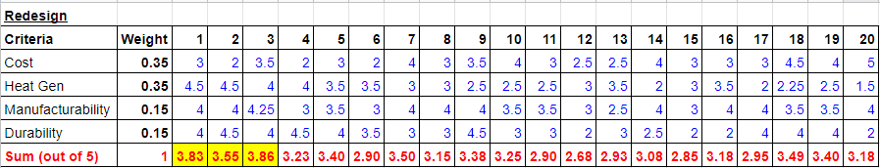
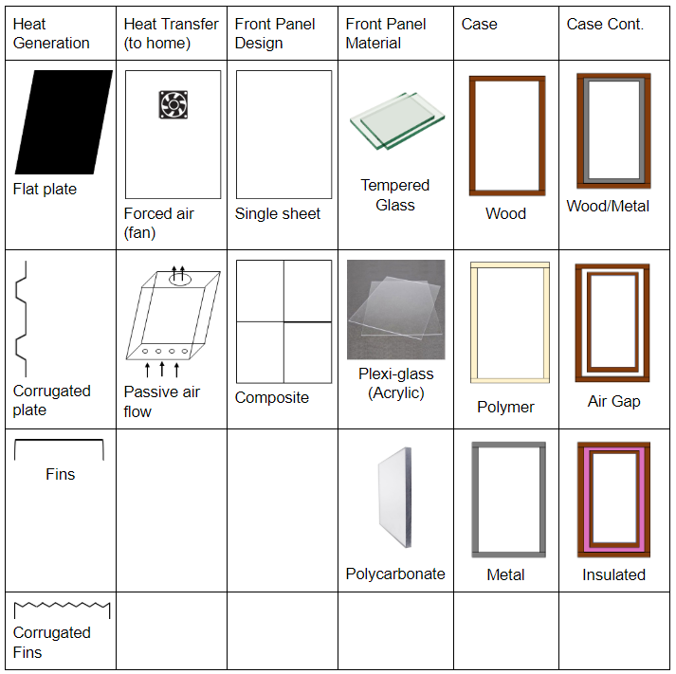
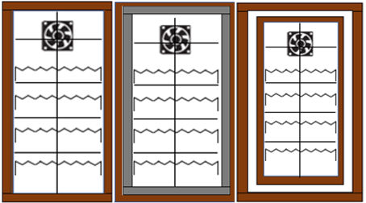
Design Decisions
Table 1: Decision Matrix
Table 2: Morph Matrix
Figure 4: Top three frame designs
Notes:
Overall design followed commercial models and previous capstone team.
Outer casing, heat transfer method and fin design were determined using a morph matrix and decision matrix.

Slide 6
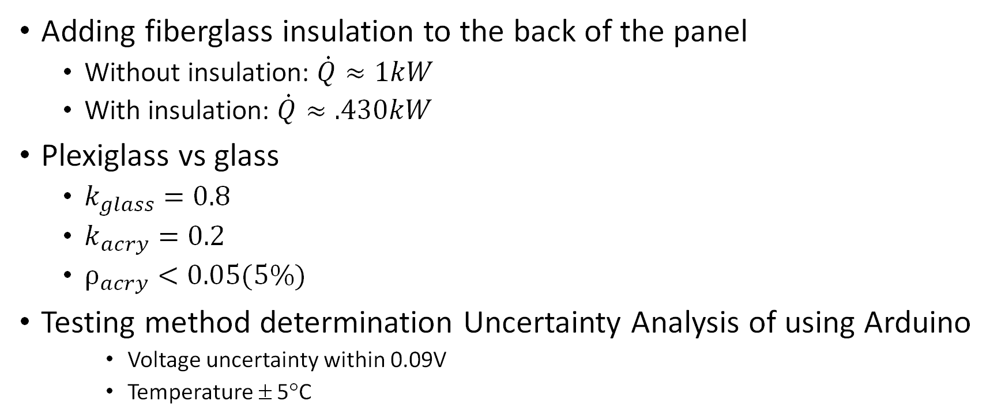
Justification of decisions
Adding fiberglass insulation to the back of the panel
  Without insulation: $\dot{Q}≈1kW$
  With insulation: $\dot{Q}≈.430kW$
Plexiglass vs glass
  $k_{glass}=0.8$
  $k_{acry}=0.2$
  $ρ_{acry}<0.05(5\%)$
Testing method determination Uncertainty Analysis of using Arduino
    Voltage uncertainty within 0.09V
    Temperature ± 5°C
Notes:
Heat transfer out back panel is for the maximum temperature the device would see. It would not be at this temp very long and thus this is not the steady state heat loss. Also this justifies running the fan continuously to reduce losses.
Plexiglass has better K values and reflectivity than glass, but a lower melting point. However we are not close to it
Uncertainty analysis yielded a voltage uncertainty of 0.09V and Temp +- 5 degrees

Slide 7
Justification of decisions
Bends in the fins
  Triangles = 2 X SA + 4 X effective
    Not used due to extra complexity and material required
  Rectangles = 1.3X S.A. & 2.7X effective.
    Design used in prototype
Fan sizing
  Target fan speed of between 120-150 CFM.
    Optimal ΔT of ≈ 50 ˚F
Solar panel sizing
  Power = voltage · Current = 12V * 2.6A = 31.2W
Notes:
Bends in fins manually. Triangles would be most effective but rquire twice as much material and time.
Went for the rectangles instead as did not ad too much work and required no extra materials but still gave a strong return in effectiveness.
Fan sizing: goal of delta T of around 50. For customer comfort, but actually reduces effiency with greater differences

Slide 8
BOM 3'x6' Model
Solar Furnace Parts | Qty | Price
2”x6”x8’ Dimensional Lumber Board | 3 | $53.76
Plexiglass Panel 0.093”x3’x6’ | 1 | $76.40
Plywood Board | 1 | $27.54
High Heat Spray Paint | 6 | $22.32
Insulated Ducting 4” x 12’ | 1 | $20.49
Heat Resistant Caulk (10.1 oz) | 1 | $14.18
Plain Aluminum Sheet 3’x3’ | 4 | $95.99
50-Watt Polycrystalline Solar | 1 | $54.45
Fan (Atwood Turbo 3000 12V) | 1 | $32.16
Solar Charge Controller | 1 | $14.99
Temperature Controller Module | 1 | $8.99
Two Pin Switch | 1 | $6.99
Fiberglass Insulation | 1 | $4.99
 |  | $438.34
Testing Equipment | Qty | Price
MAX6675 Thermocouple | 1 | $8.29
Arduino Starter Kit | 1 | $85.90
Anemometer | 1 | $29.99
 |  | $124.18
Table 4: Testing BOM
Price for 100 units: $384.04/unit
    Requirement: $400
    Goal: $350
Table 3: 3'x6' Model BOM
Notes:
3x6 model for 100 units bulk, $384.04

Slide 9
Bulk Pricing for 100 units 4'x8' model
BOM | Qty | Unit Price
2'x6'x10' Lumber | 3 | $45.69
2'x4'x3/8" Plexiglass | 1 | $158.20
Plywood Board | 1 | $24.35
High Heat Paint | 6 | $22.32
Insulated Ducting 4"x12' | 1 | $18.77
Heat Resistant Caulk | 1 | $2.08
Plain Aluminum Sheet | 4 | $81.92
50-Watt Polycrystalline Solar | 1 | $54.45
Fan | 1 | $32.16
Solar Controller | 1 | $14.99
Temperature Controller Module | 1 | $8.99
Switch | 1 | $6.99
Fiberglass Insulation | 18 sq ft | $4.99
Total Remaining |  | $475.90
Table 5: 4'x8' Model BOM
Notes:
Completed a cost analysis for 4'x8' model in case red feather needs to use the design to heat larger structures

Slide 10
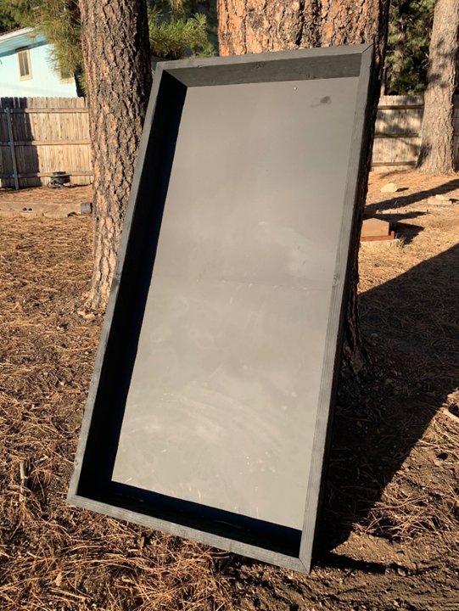
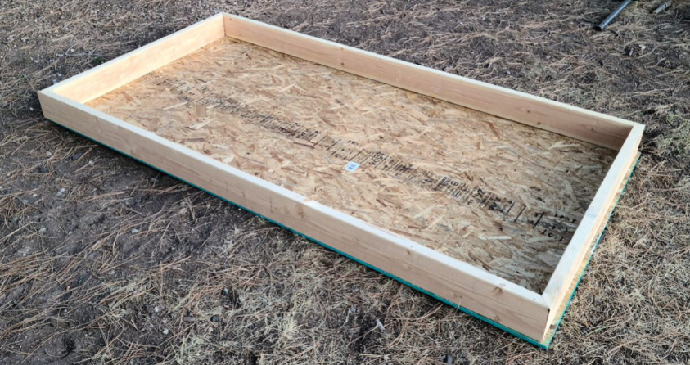
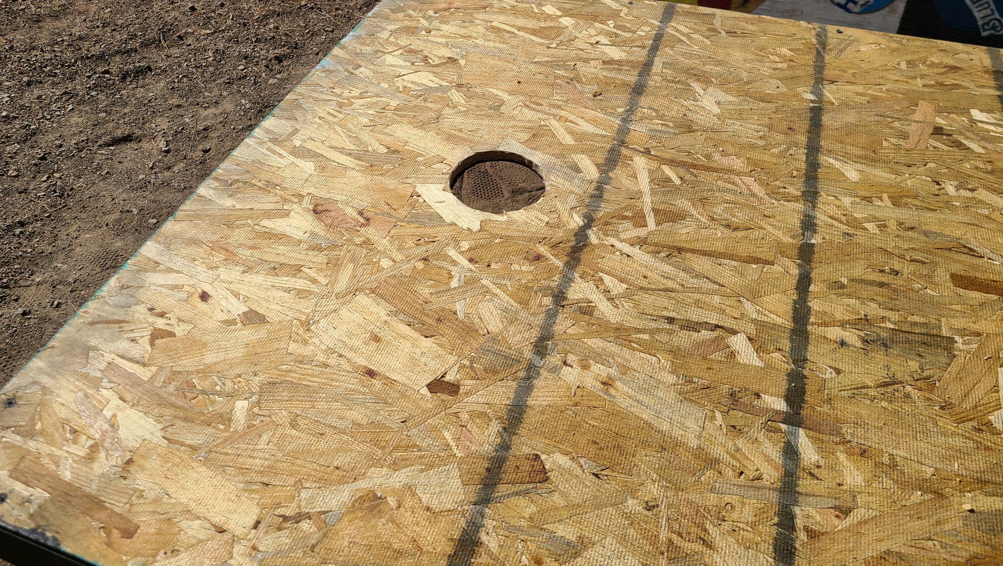
Manufacturing
Figure 5: Wooden Frame
Figure 7: Hole Cut
Figure 6: High Heat Spray Paint

Slide 11
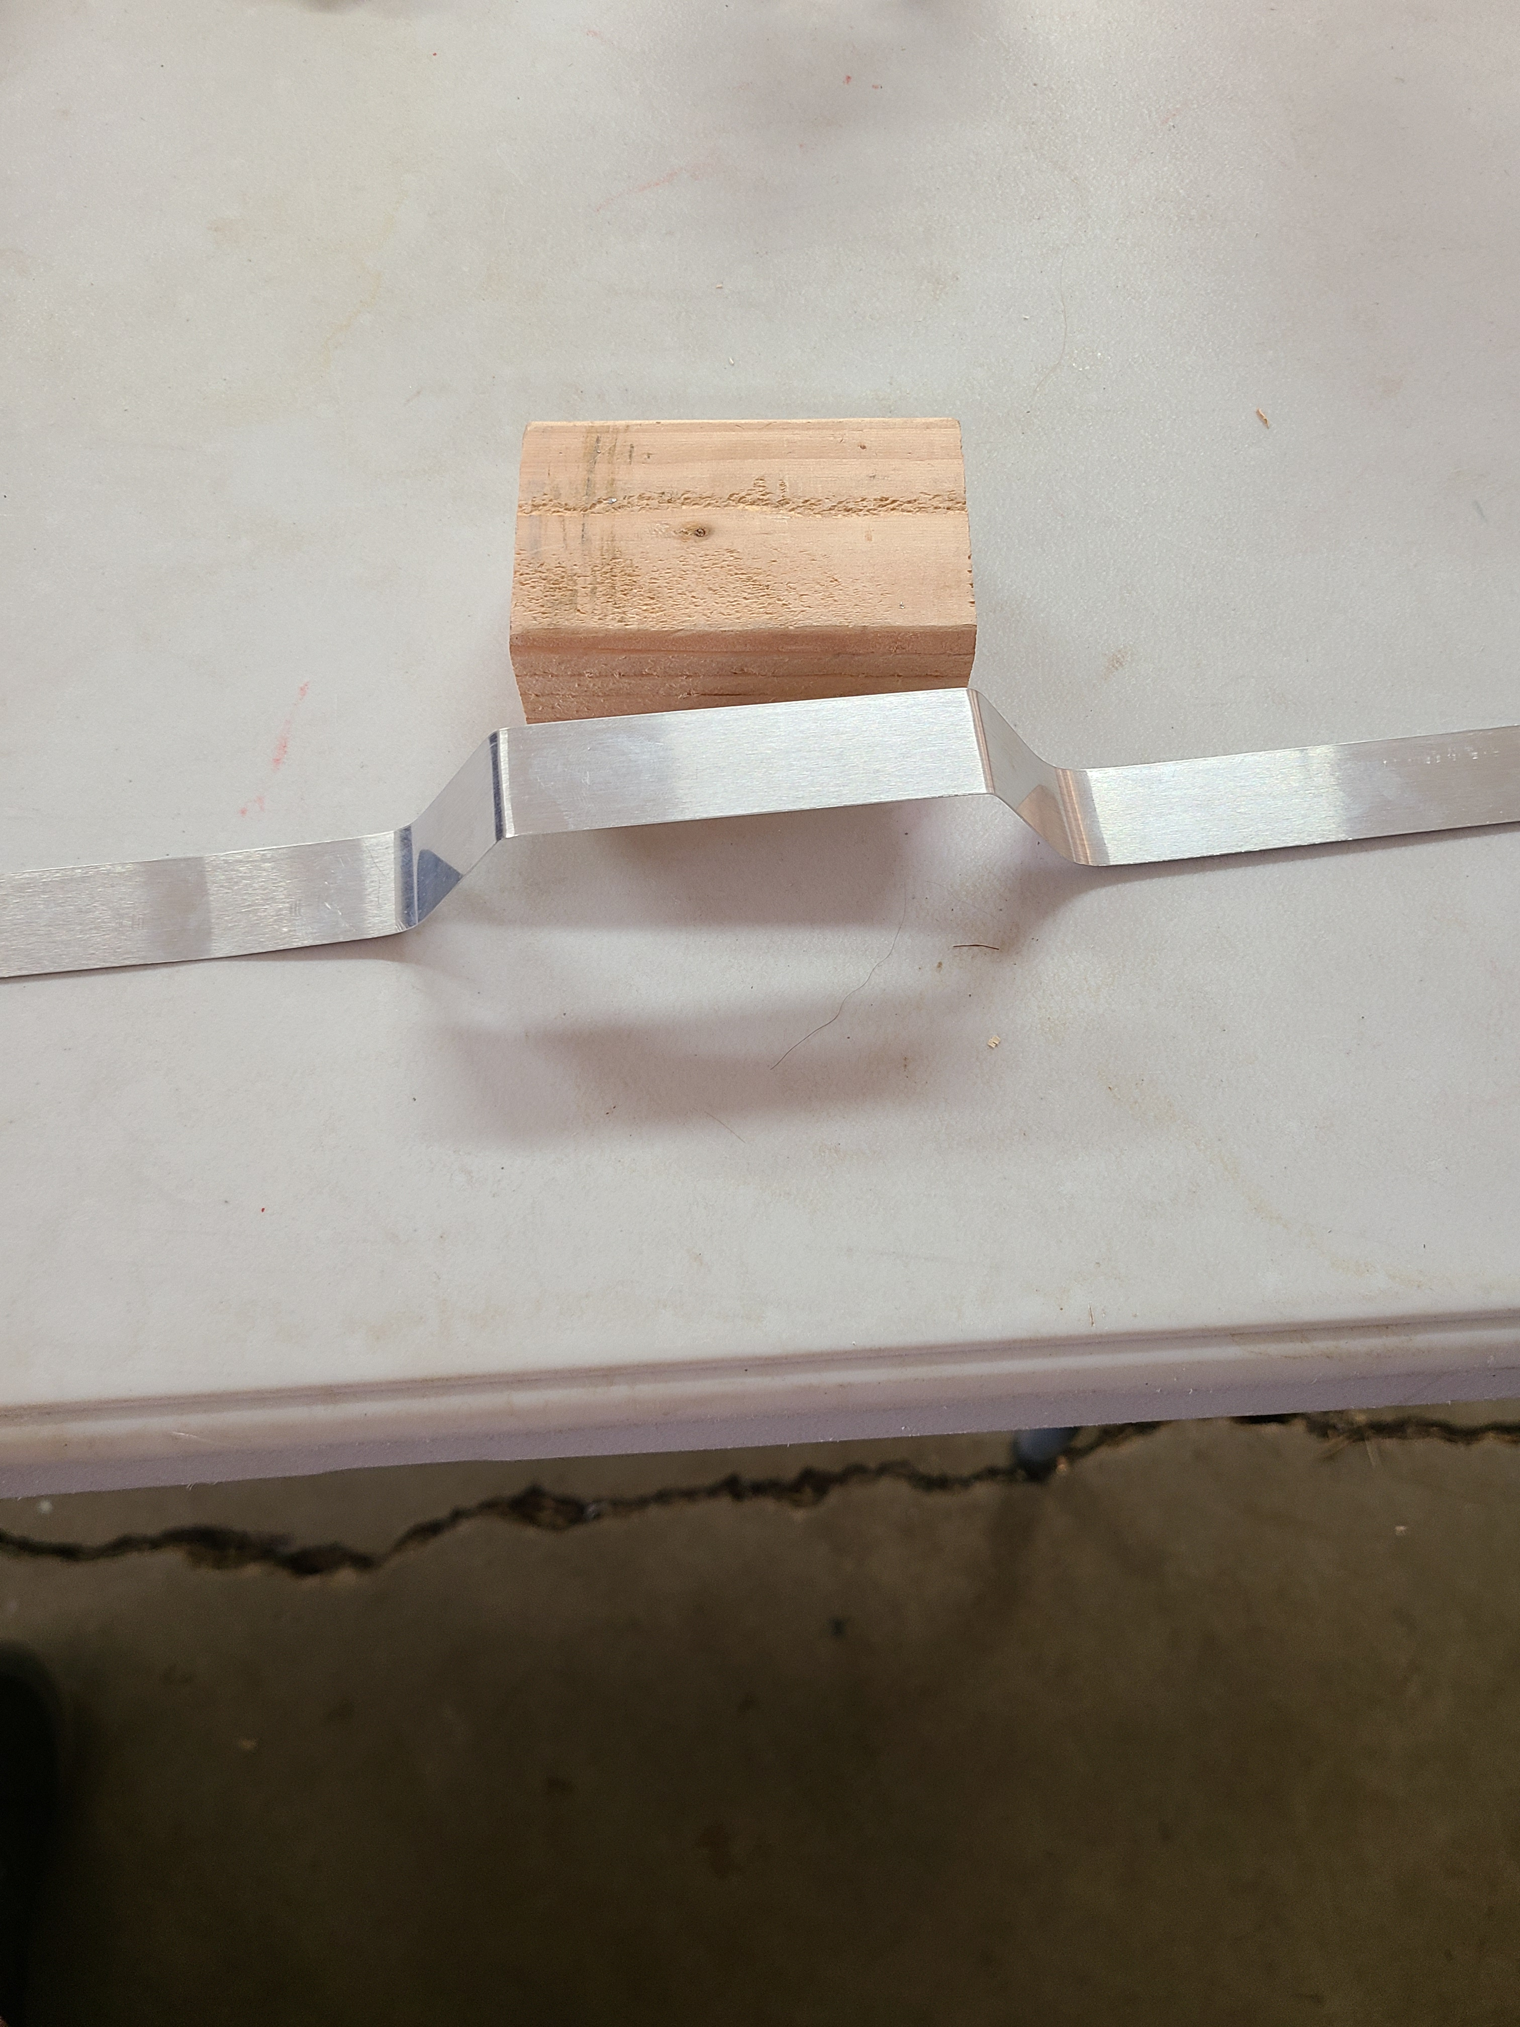
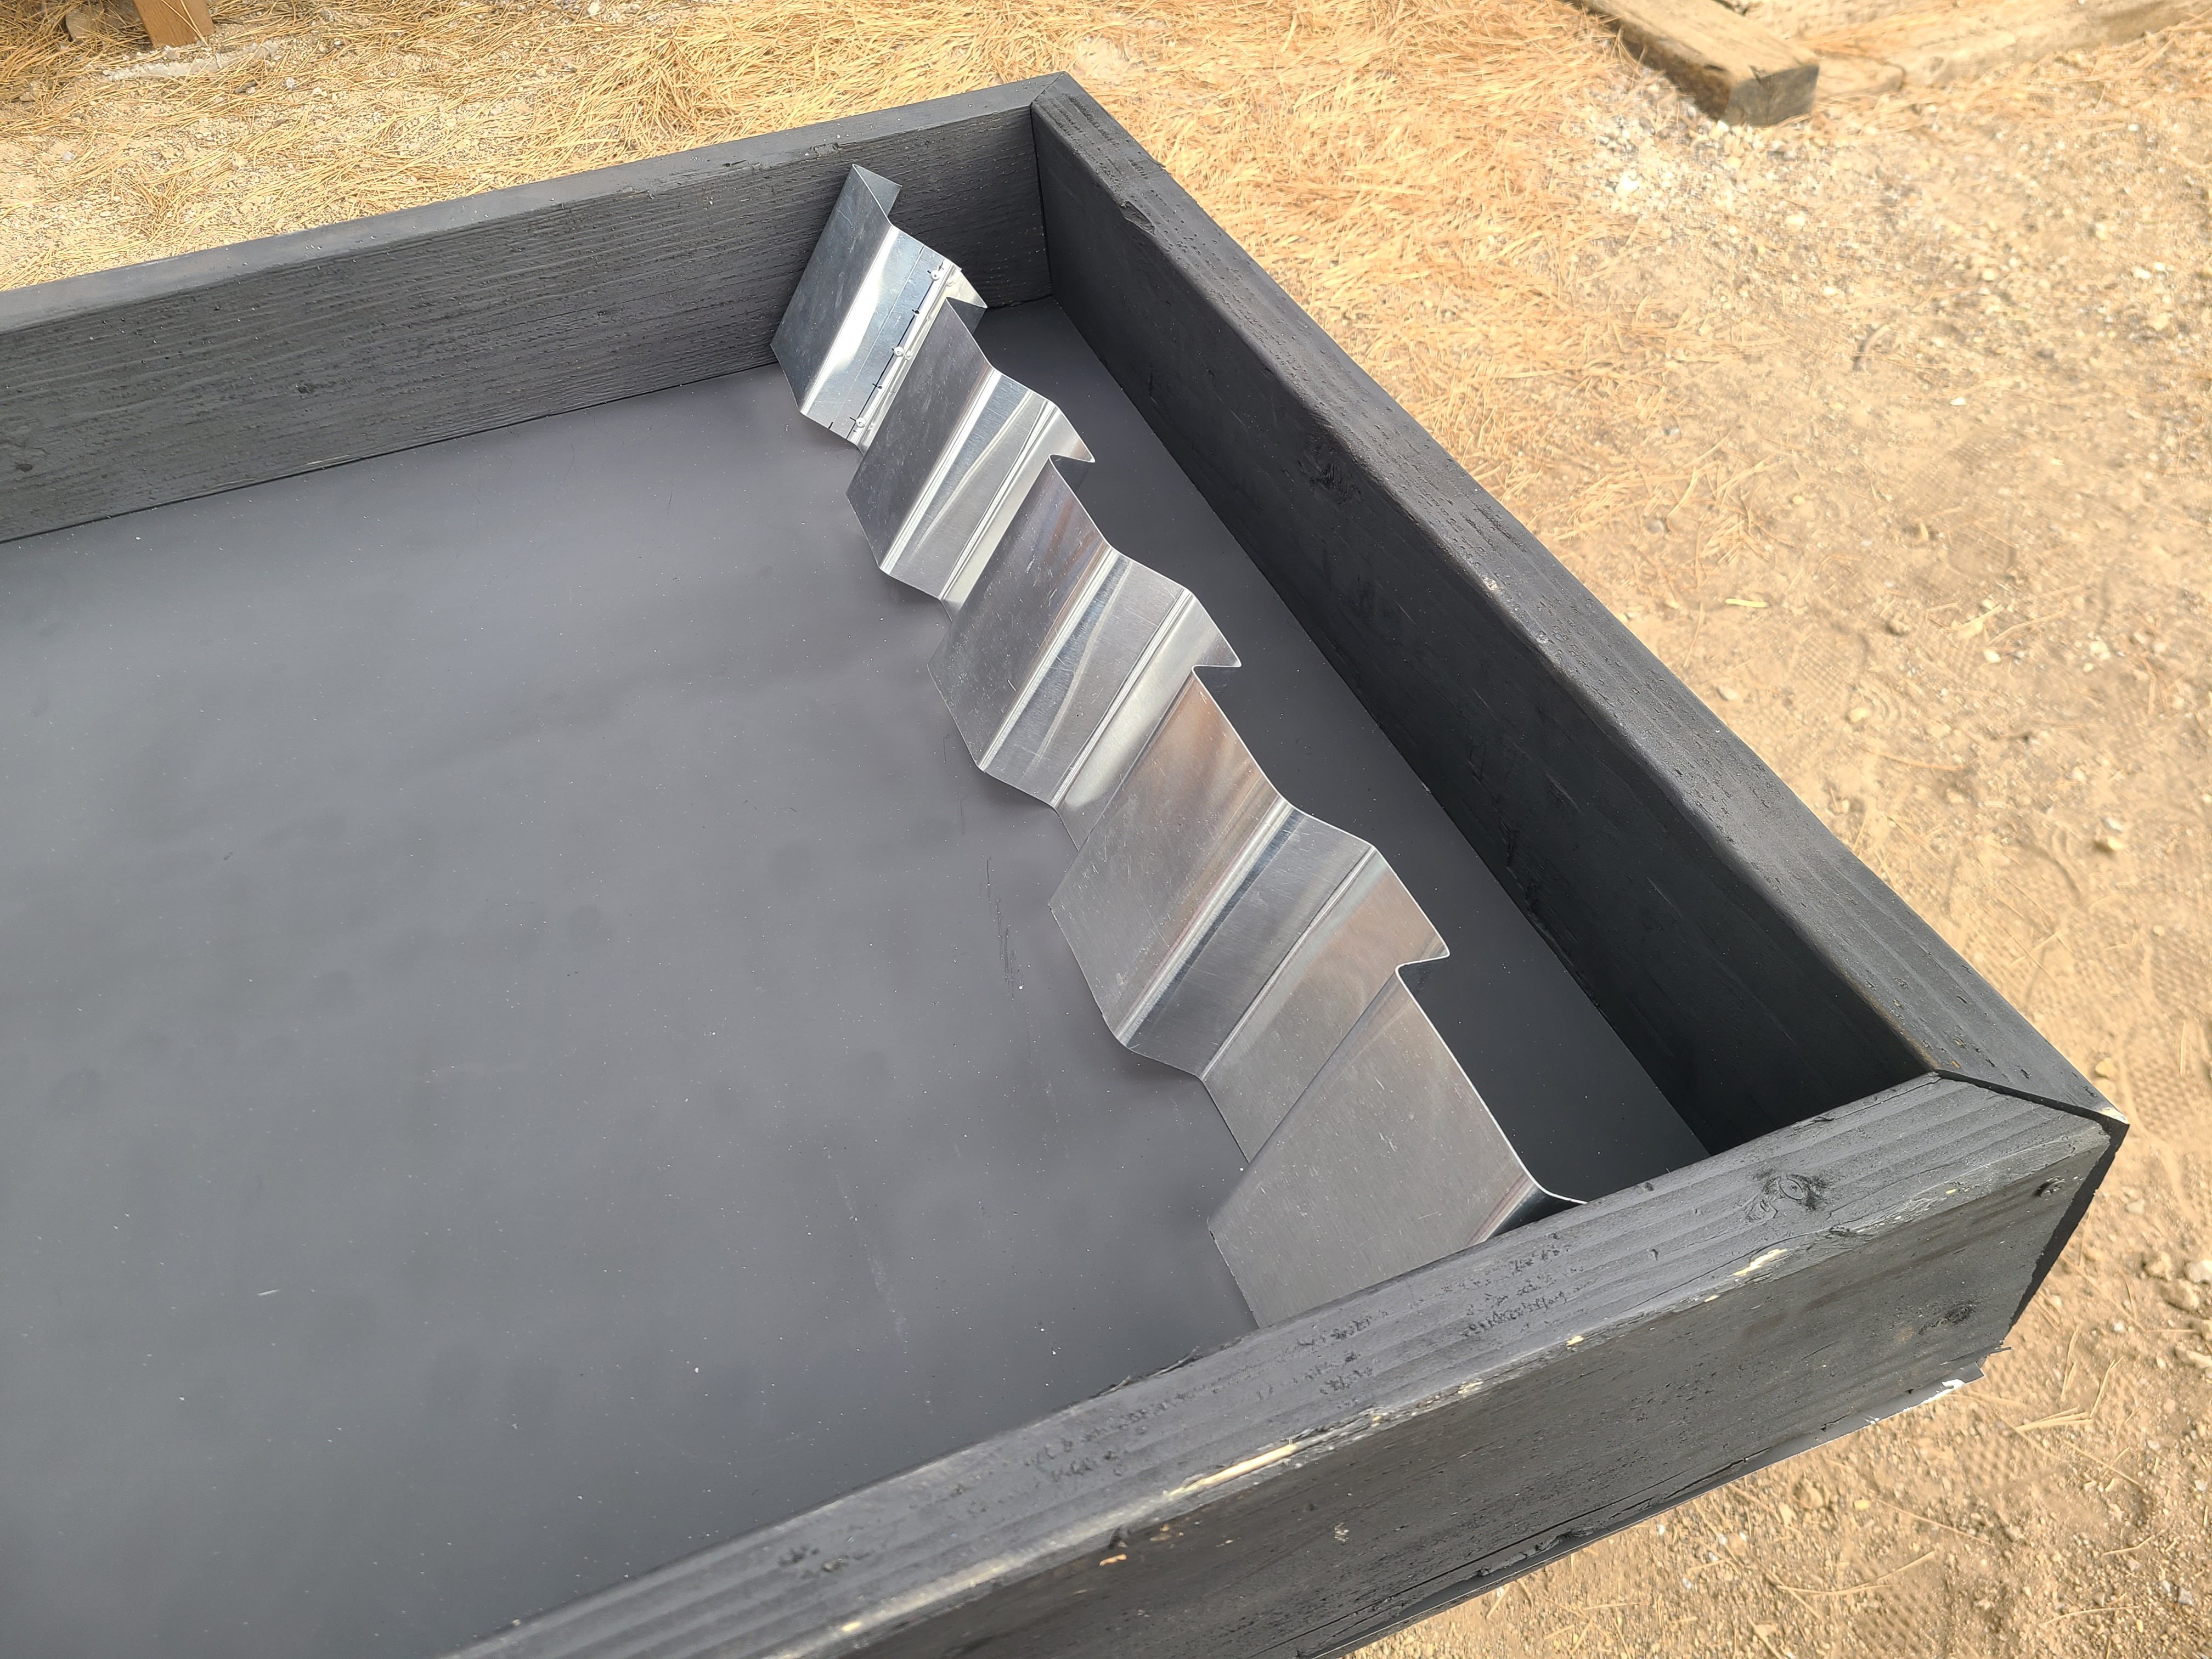
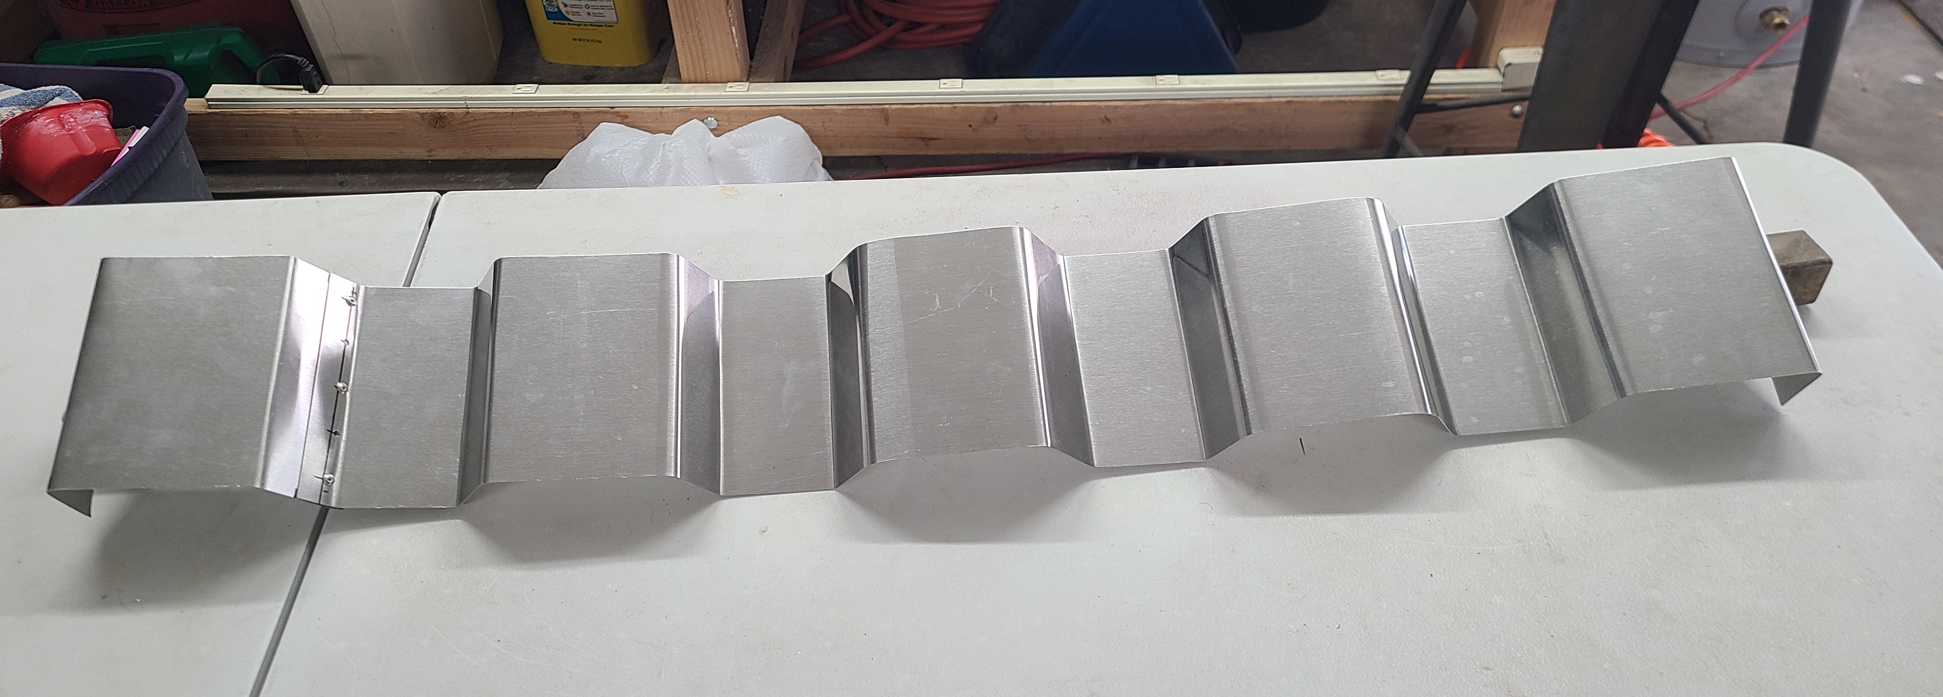
Manufacturing
Figure 8: Bent Fin Prototype
Figure 9: Bent Fins
Figure 10: Bent Fins in Frame

Slide 12
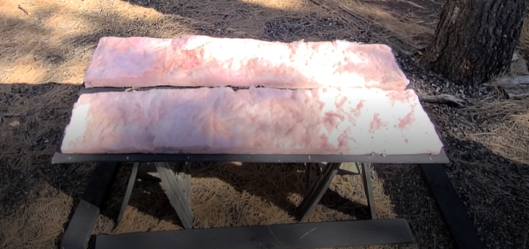
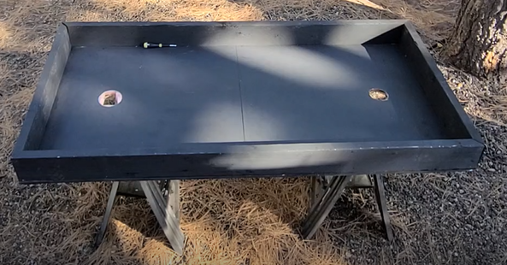
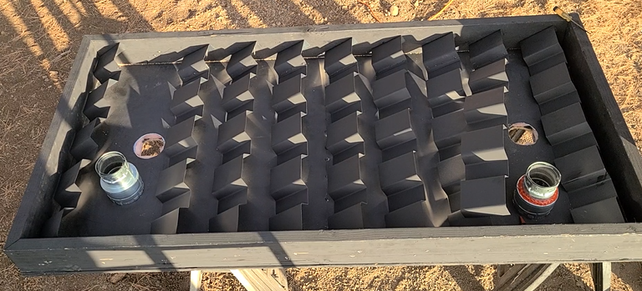
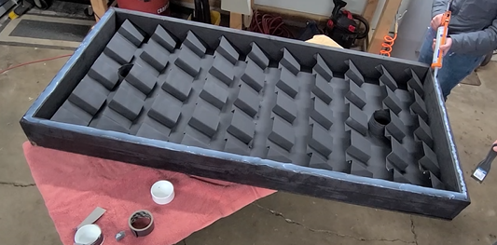
Manufacturing
Figure 11: Insulation
Figure 12: Insulation in Frame
Figure 13: Furnace Fins
Figure 14: Sealant on Frame

Slide 13
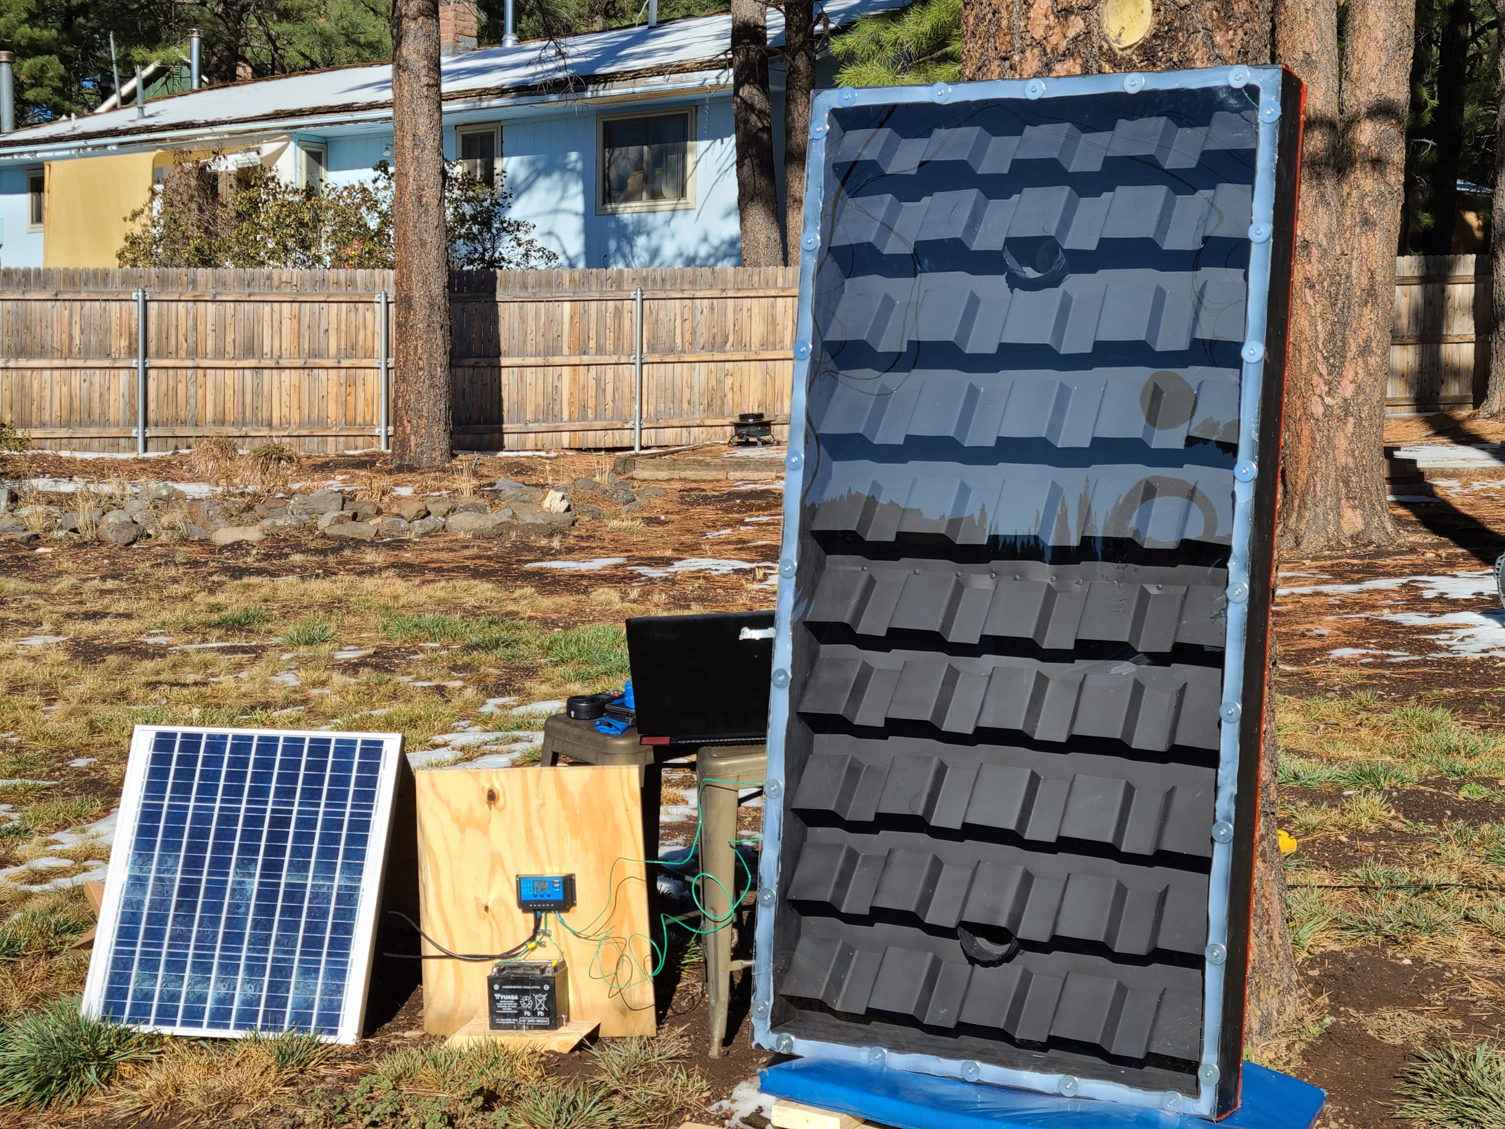
Finished Prototype
Figure 15: Completed prototype and testing setup
Notes:
Solar charge controller

Slide 14
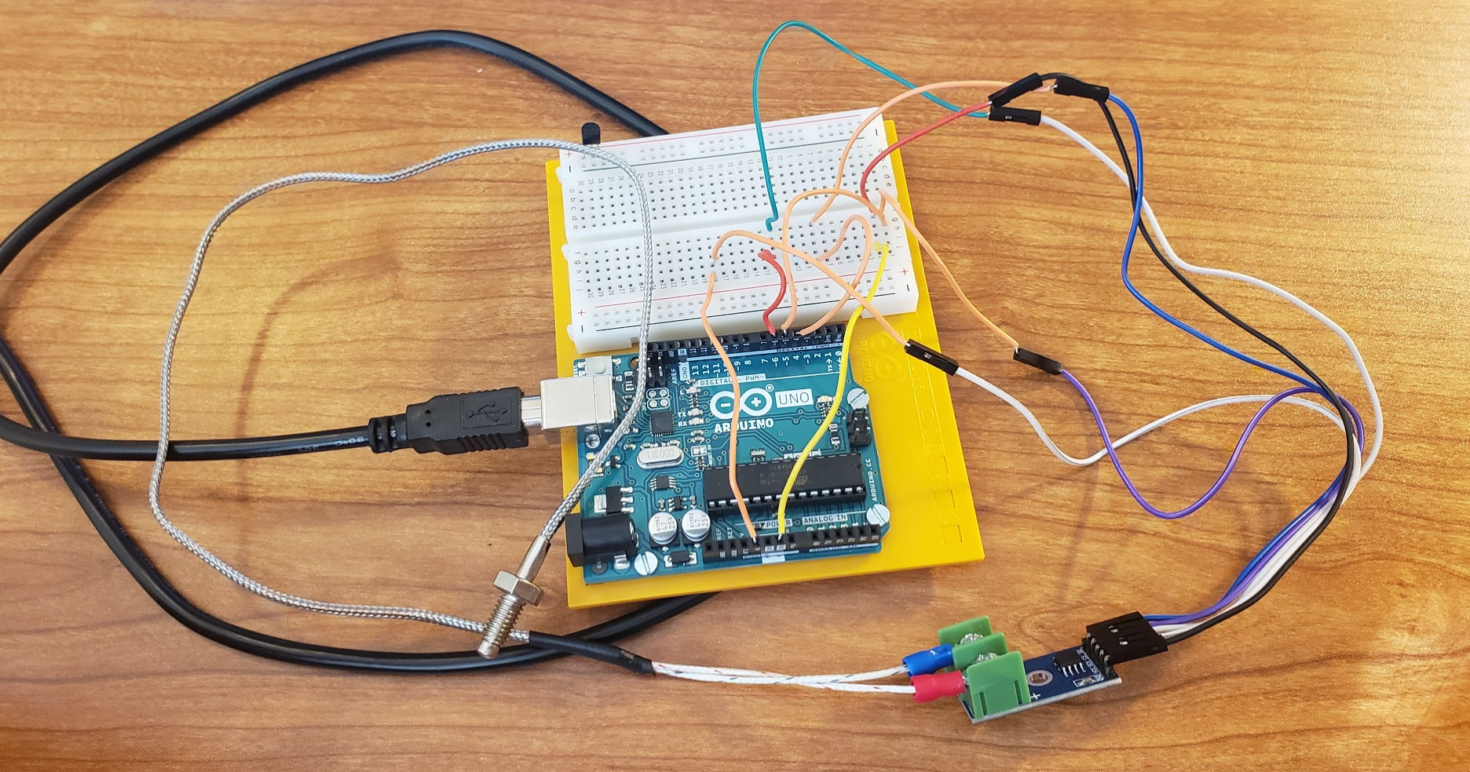
Testing: Setup
  Arduino and Anemometer used to test heat output
    MAX6675 thermocouple used with Arduino to find temperature of air leaving device
    Anemometer used to find air speed out of device
Figure 16: Arduino Board​
Notes:
-uncertainty analysis to calibrate temperature
-testing in middle of day from 2-4ish pm

Slide 15
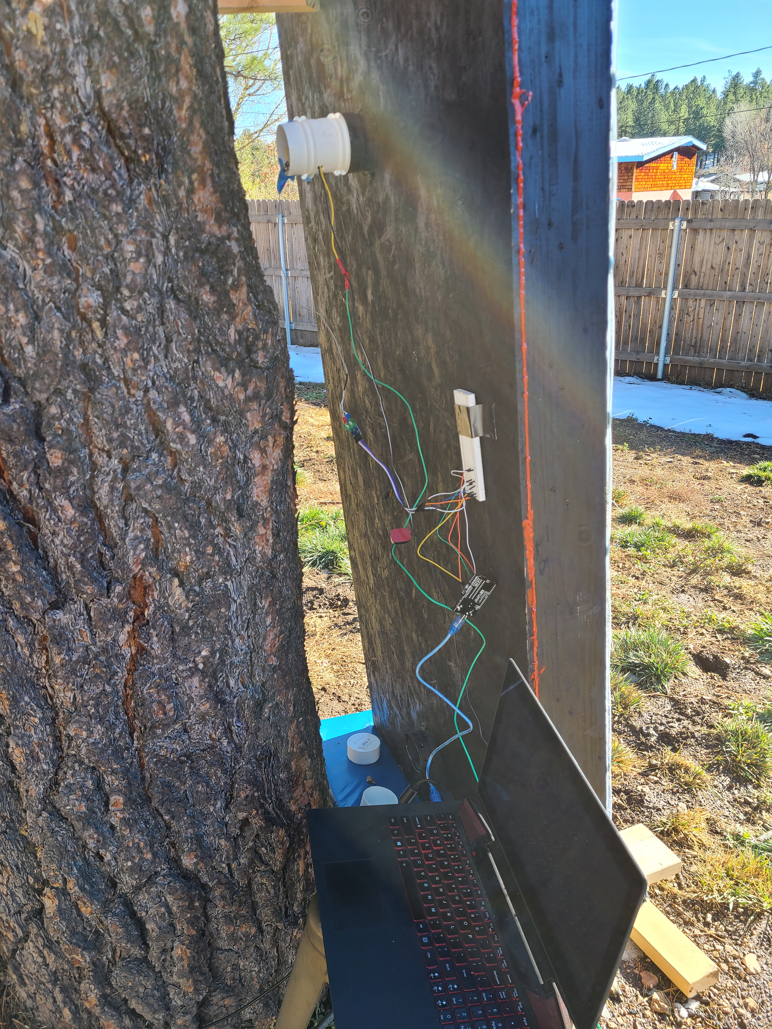
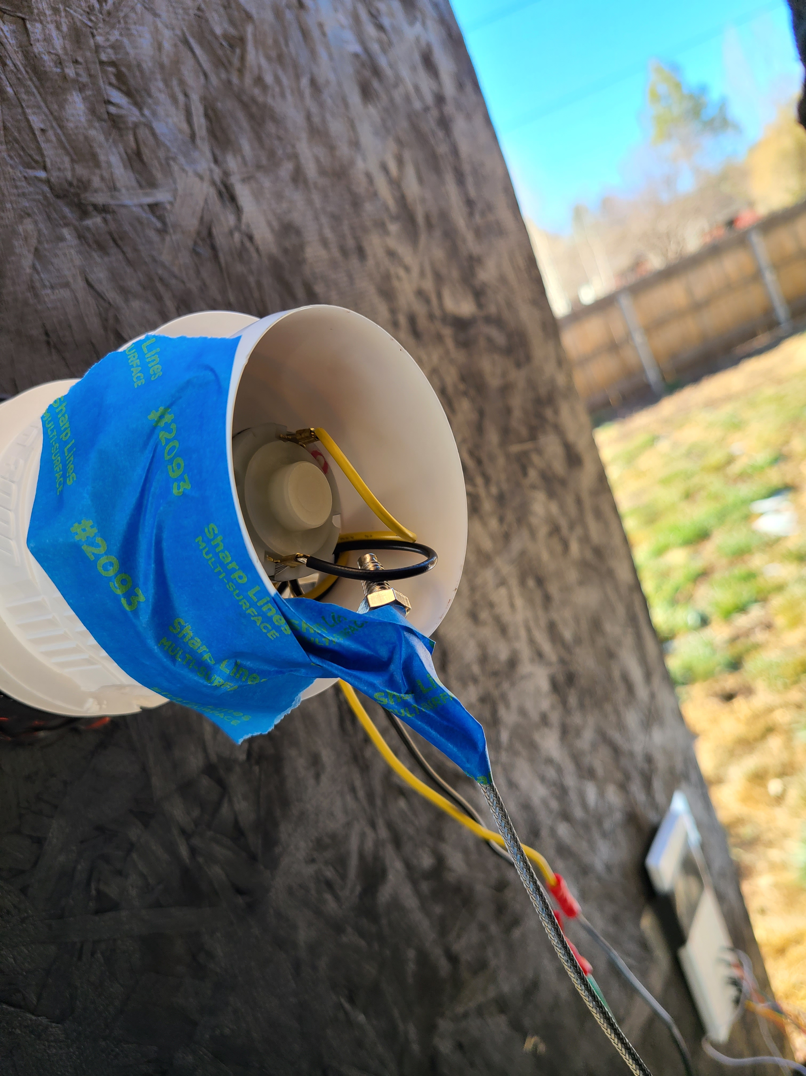
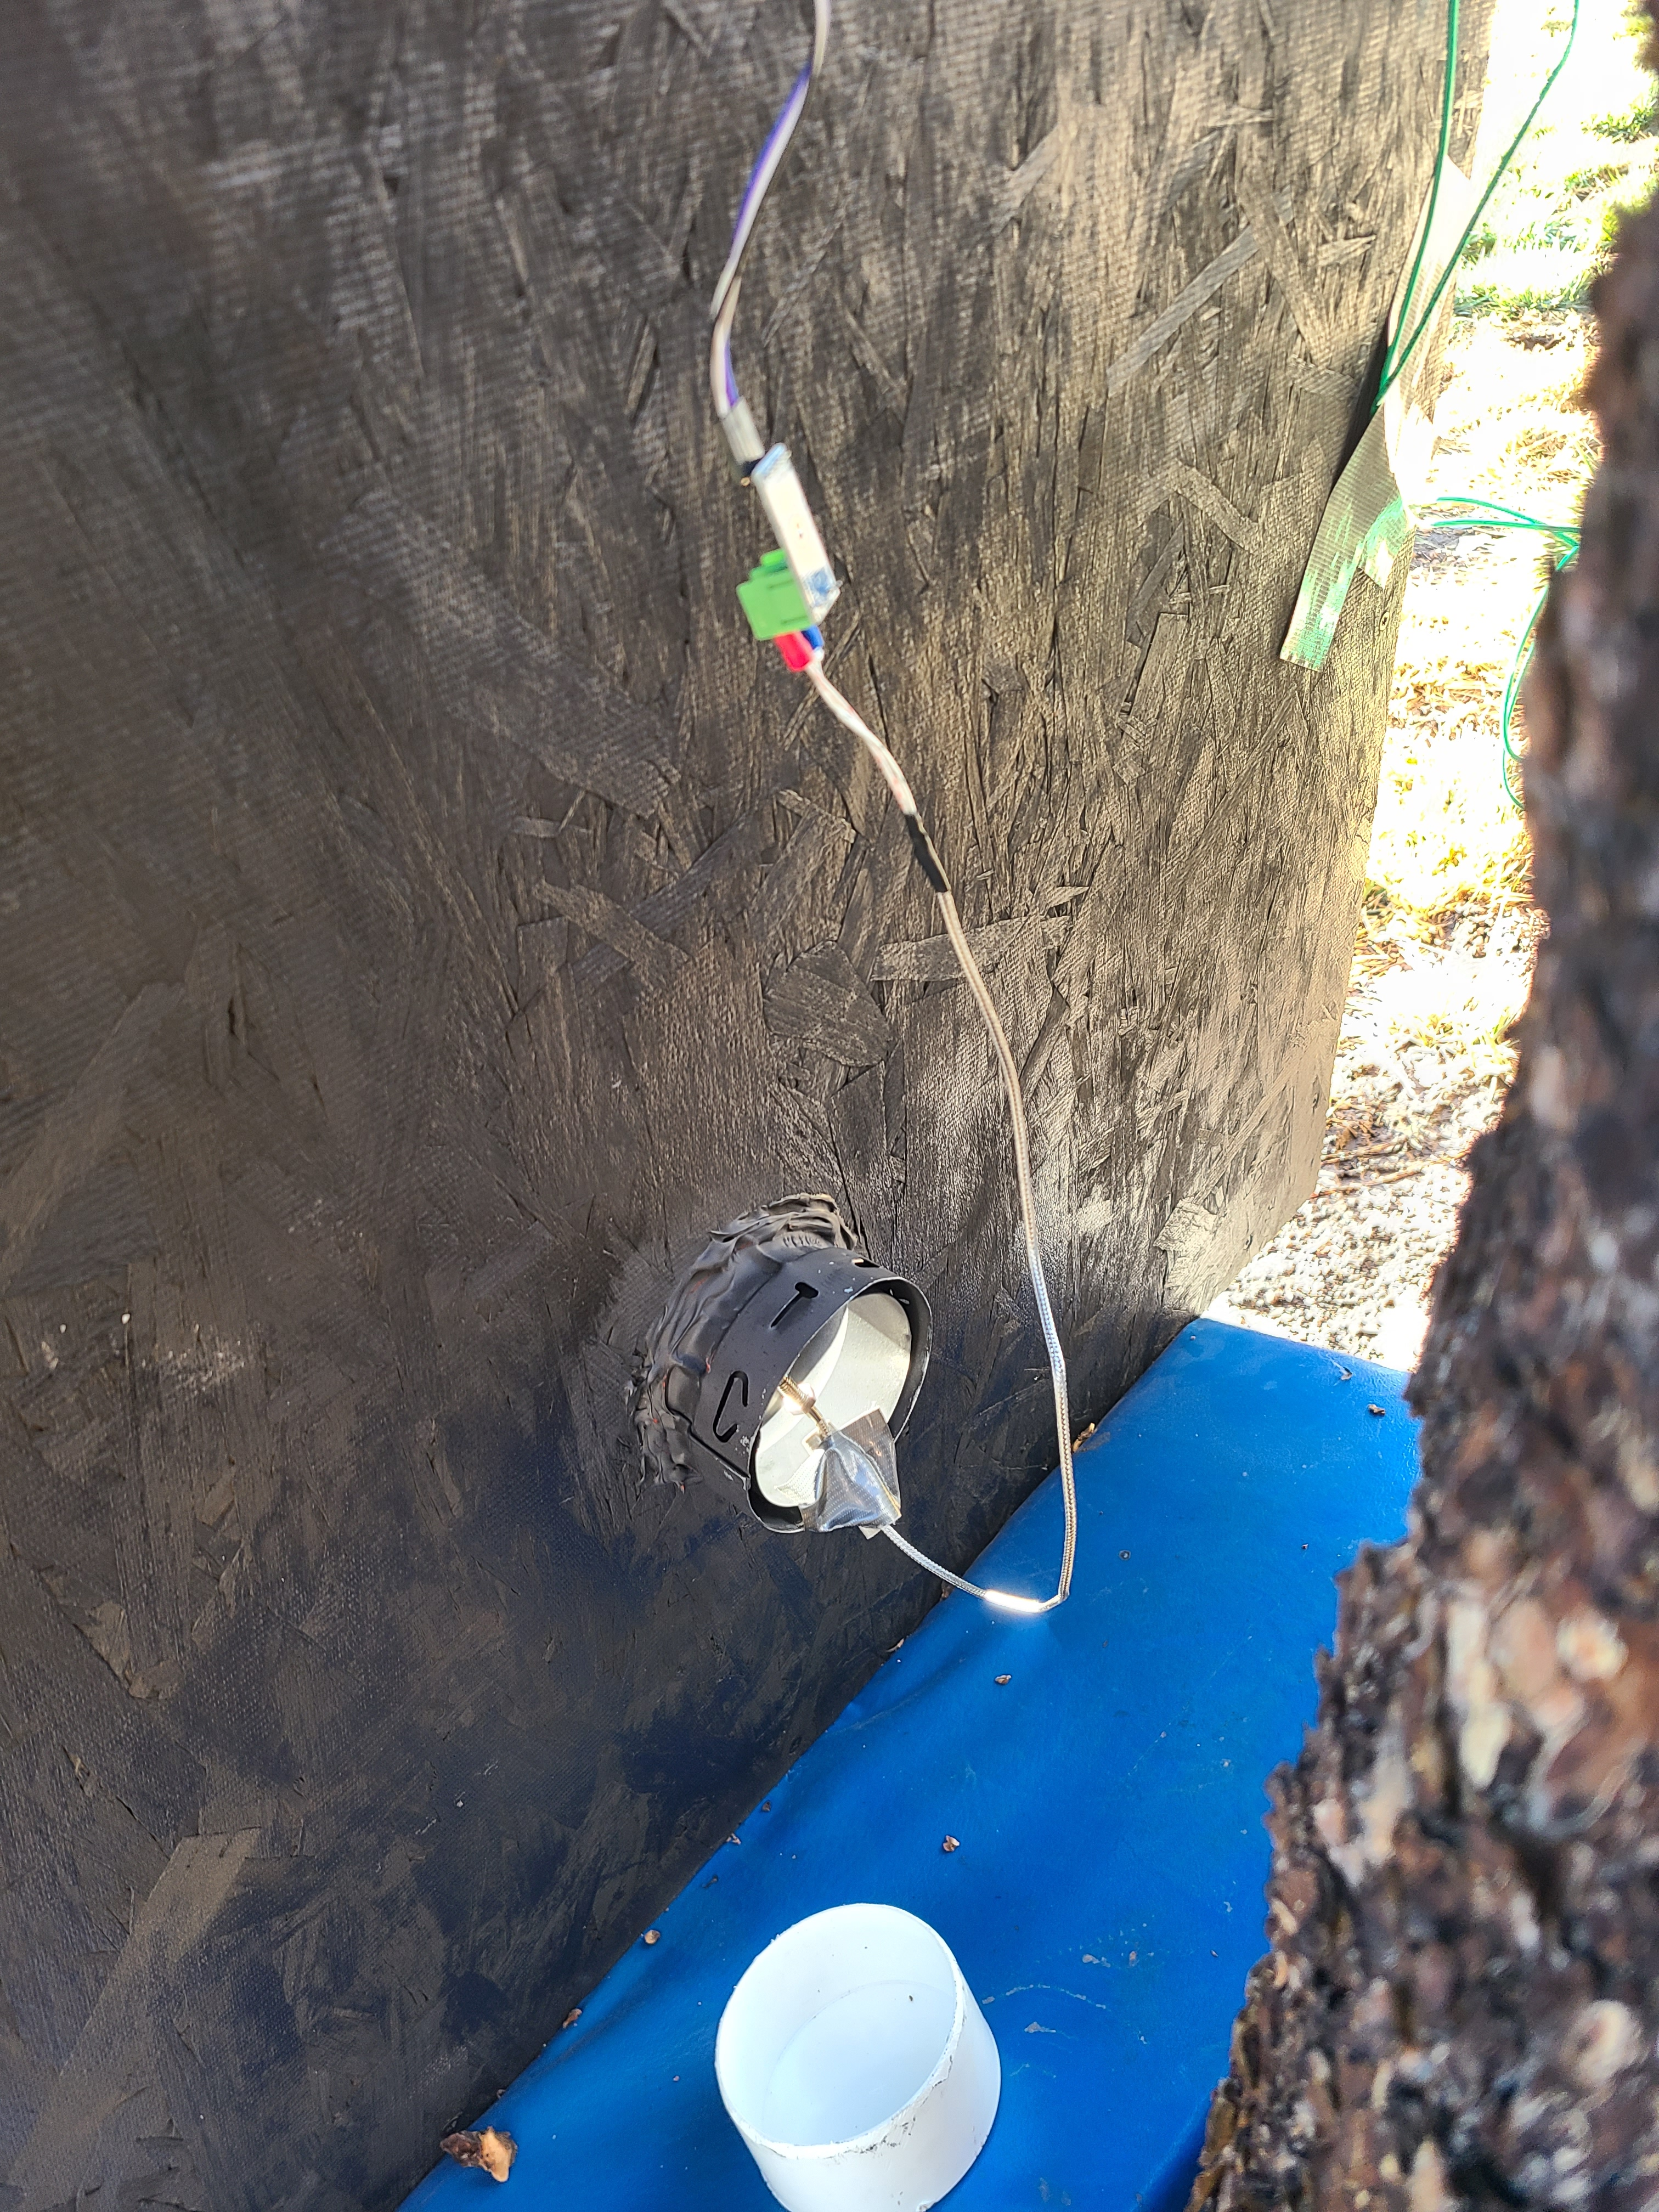
Testing: Setup
Figure 17: Testing Setup
Figure 18: Testing Wires
Figure 19: Testing Thermocouple

Slide 16
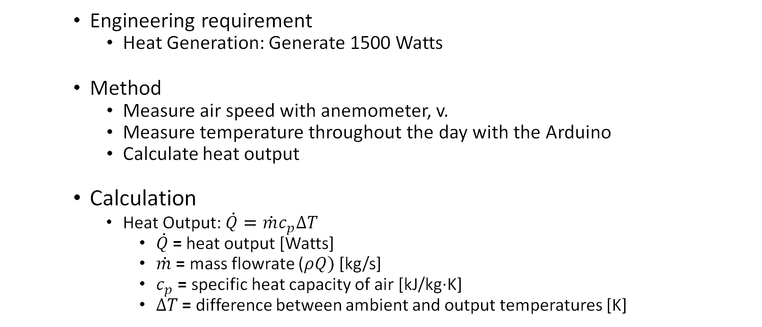
Testing: Calculations
    Engineering requirement
      Heat Generation: Generate 1500 Watts
    Method
      Measure air speed with anemometer, v.
      Measure temperature throughout the day with the Arduino
      Calculate heat output
    Calculation
      Heat Output: $\dot{Q}=\dot{m}c_{p}∆T$
        $\dot{Q}$= heat output [Watts]
        $\dot{m}$ = mass flowrate ($ρQ)$ [kg/s]
        $c_{p}$ = specific heat capacity of air [kJ/kg·K]
        $∆T$ = difference between ambient and output temperatures [K]
Notes:
-1500 scaled down with prototype
-similar to arctica solar
-produced around 1400-1700 watts

Slide 17
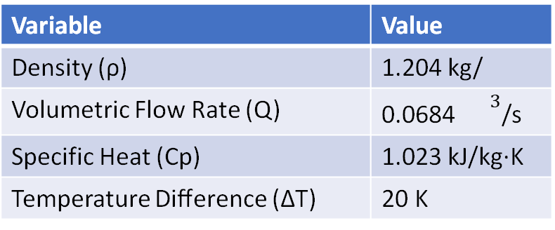
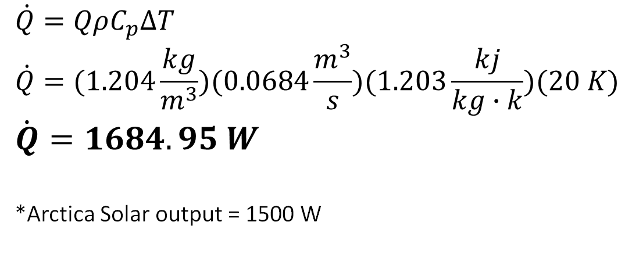
Testing: Results
Avg Inlet Temperature | Avg Outlet Temperature
50.49 °F | 86.48 °F
10.27 °C | 30.27 °C
283.42 K | 303.42 K
Variable | Value
Density (ρ) | 1.204 kg/
Volumetric Flow Rate (Q) | 0.0684 ${}^{ 3}$/s
Specific Heat (Cp) | 1.023 kJ/kg·K
​Temperature Difference (ΔT) | ​20 K
Table 6: Inlet/outlet temperatures
Table 7: Calculation Variables
$$\dot{Q}=QρC_{p}∆T$$
$$\dot{Q}=(1.204\frac{kg}{m^{3}})(0.0684\frac{m^{3}}{s})(1.203\frac{kj}{kg∙k})(20 K)$$
$$\dot{Q}=1684.95 W$$
*Arctica Solar output = 1500 W
Notes:
-1500 scaled down with prototype
-similar to arctica solar
-produced around 1400-1700 watts

Slide 18
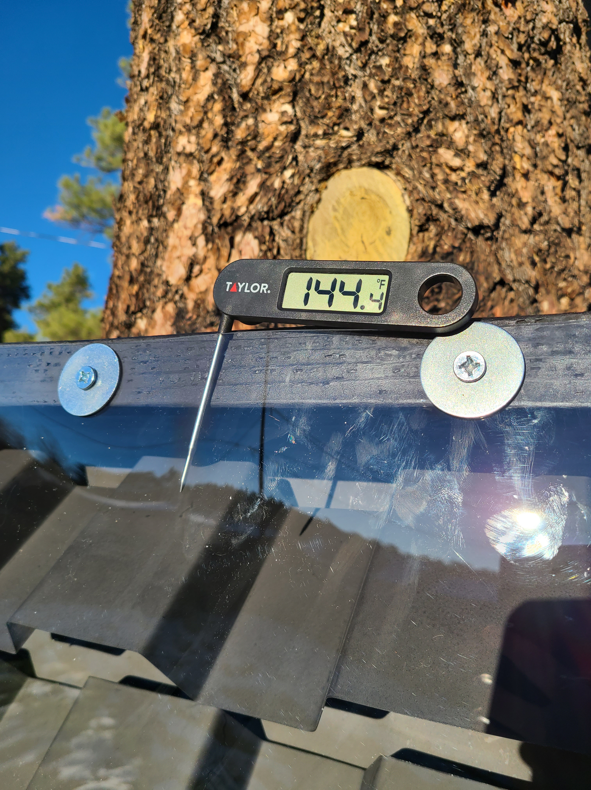
Testing: Results
1684.95 W, requirement: 1500W
Equivalent to 5749.3 Btu/hr.
Will comfortably heat between 500-800 sqft.
Space heater electricity cost (8 hours)= $1.50/day
Max Temp with fan off = 149 °F.
Total Weight 81 lbs.
Figure 20: Cooking Thermometer in Prototype
Notes:
Won't melt
Under weight requirement of around 100 lbs

Slide 19
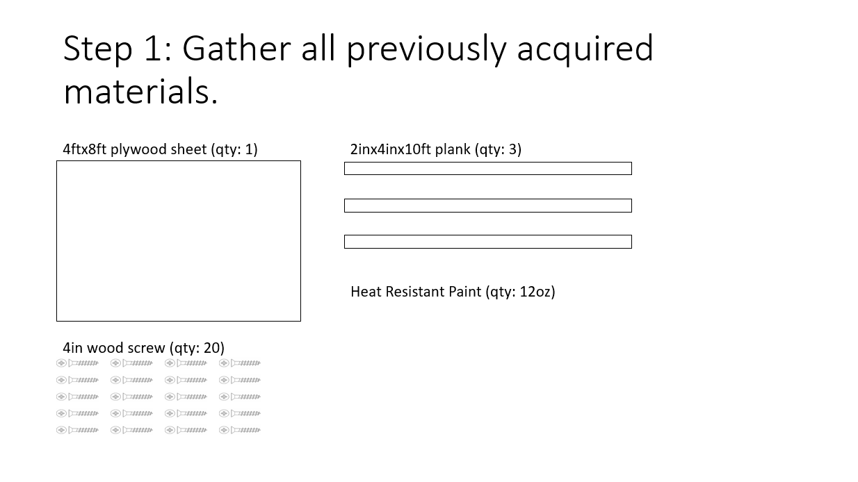
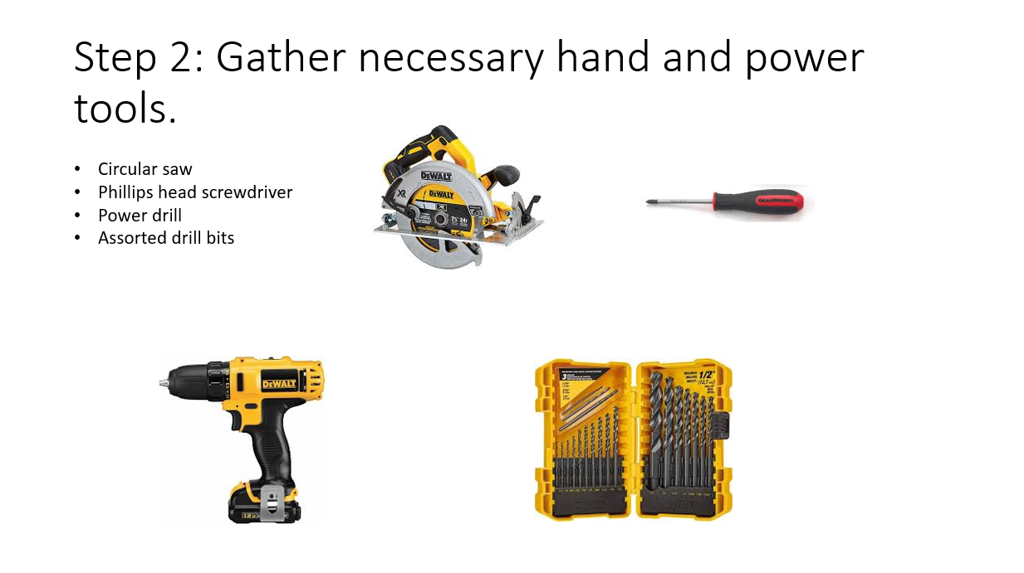
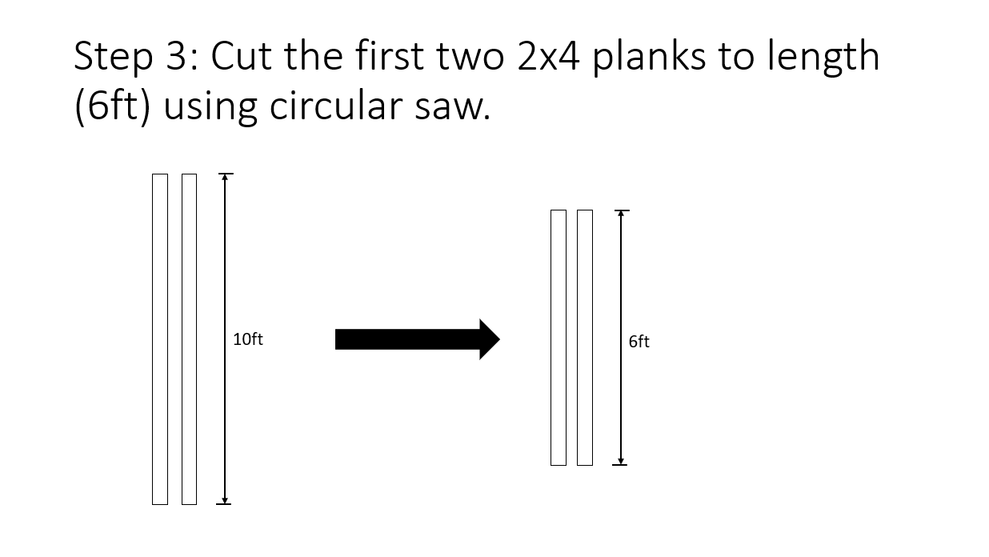
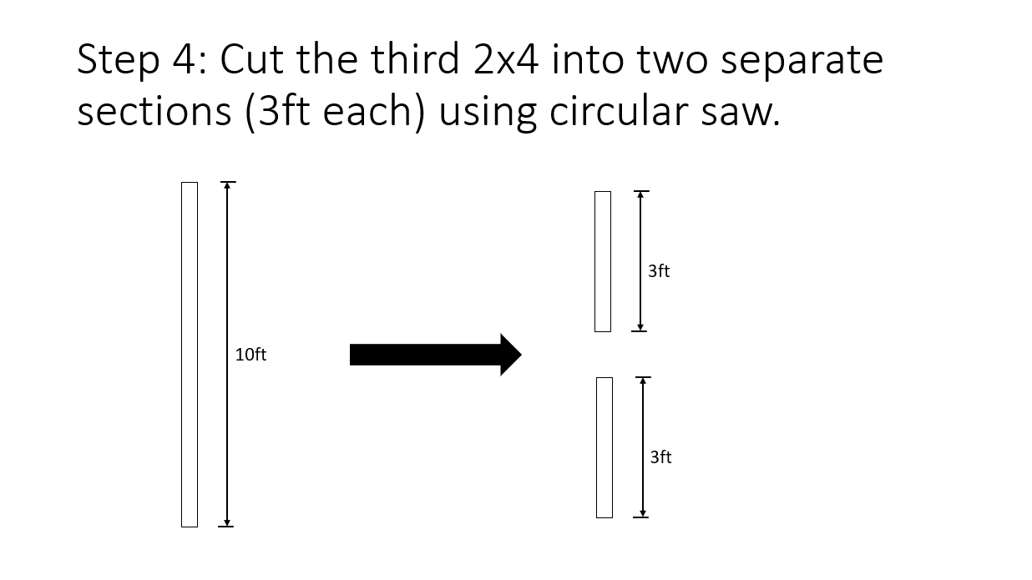
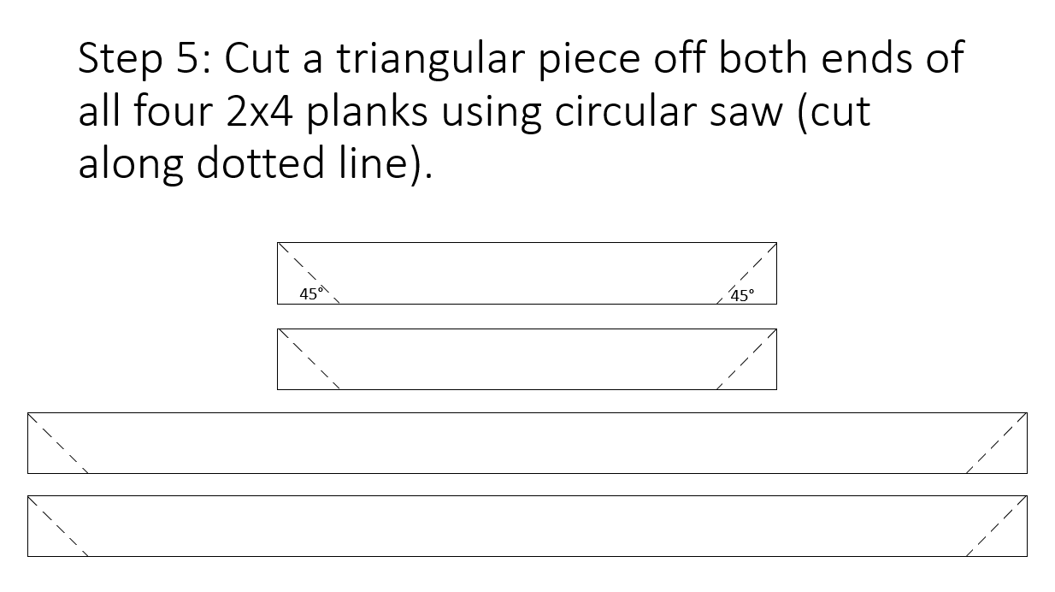


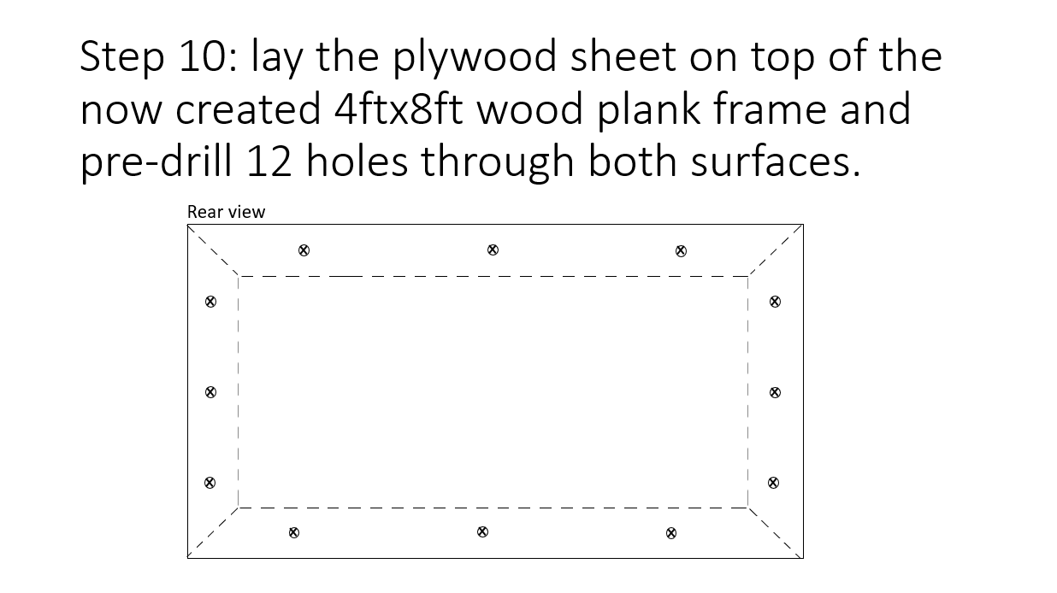
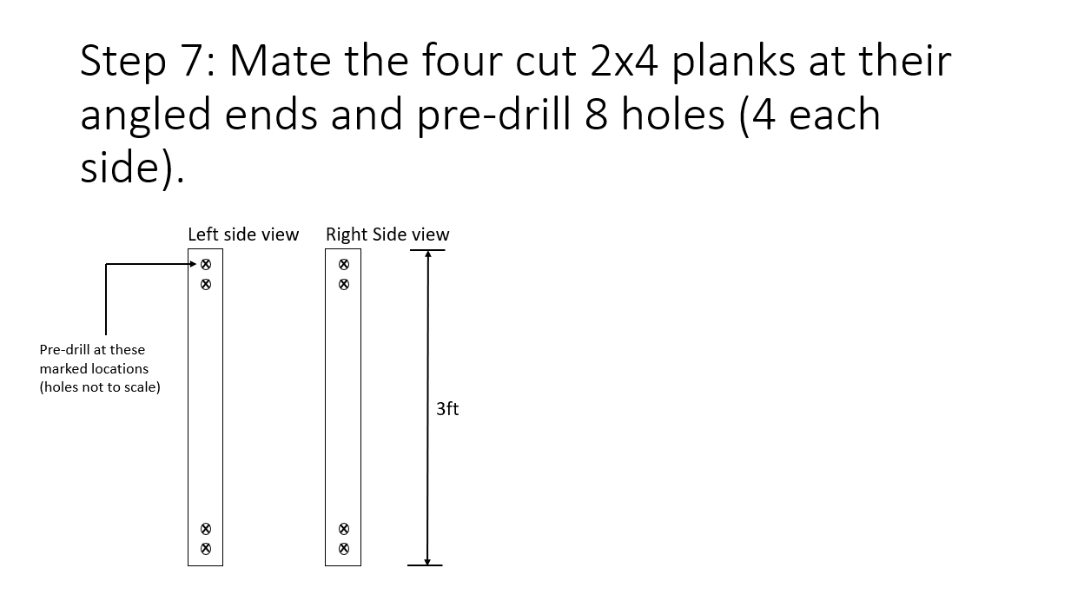

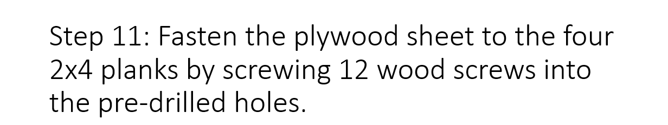
Construction Plan
Notes:
Construction plan details how to replicate the build process. Done in phases throughout construction. Discusses everything from furnace build to wiring the electronics and different options for settings.

Slide 20
Future Work: Design Improvements
  Furnace Improvements:
    Better insulation
      Double layer of acrylic with air gap
      Tighter tolerances
  Acrylic sheet changes
    Thicker sheet to reduce cracking and increase insulation
    Revise mounting design to reduce cracking and improve air seal
  Voltage regulator instead of thermostat
    Adjustable temperature differential
    Can slow fan speed to run continuously and reduce noise

Slide 21
Future Work: Further testing
  More testing is needed under different conditions
    Currently only tested at around 50 degrees in clear weather.
    Collect solar irradiance values in order to calculate heat output in different weather.
  Compare losses for improved plexiglass installation method
  A life cycle analysis for all materials used.

Slide 22
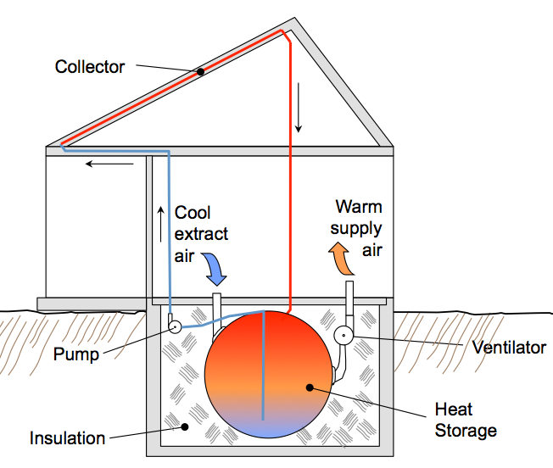
Future Work: Thermal Battery
  Thermal Battery:
    The Thermal Battery Team is attempting to store some of the heat created by the furnace to be used past sunset.
Figure 21: Simple Thermal Storage System [4]

Slide 23
References
[1] “Red Feather Solar Furnace 2,” Northern Arizona University, Jan-2020.
[2] “Digital Wind Anemometer". [Online]. Available: https://www.walmart.com/ip/Wind-Thermometer-Meter-Outdoors-PEAKMETER-CFM-Fishing-Gauges-Sailing-Backlight-Speed-Data-Anemometer-Air-LCD-Surfing-Weather-Portable-Collection-Hand/984442297?wmlspartner=wmtlabs&adid=22222222222299092587&wmlspartner=wmtlabs&wl0=e&wl1=o&wl2=c&wl3=74904344636201&wl4=pla-4578503890345144&wl5=&wl6=&wl7=&%20wl10=Walmart&wl12=984442297_10001020730&wl14=anemometer&veh=sem
[3] F. P. Incropera, T. L. Bergman, D. P. Dewitt, and A. S. Lavine, Incroperas Principles of Heat and Mass Transfer. John Wiley & Sons, 2017.
[4] Ecohome Published: Nov. 15, Ecohome, & Reynolds, D. (n.d.). How do thermal batteries work? Retrieved November 09, 2020, from https://www.ecohome.net/guides/2208/thermal-batteries-all-about-storing-solar-heat/

